Slide 1

Test Strategy

Slide 2
Agenda
Introduction
BDD
Test Levels
Testing Types
Test Execution
Test Automation
QA Tool-set
Defect Management

Slide 3
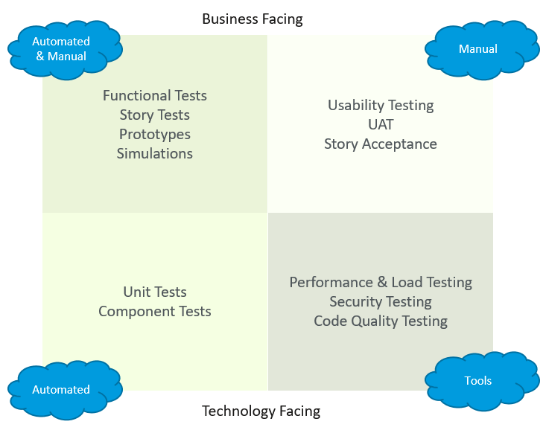
Introduction
Let us include a reminder for everyone about Quality Assurance
QA is a set of activities intended to ensure that products satisfy customer requirements in a systematic, reliable fashion.
In SCRUM (agile) QA is the responsibility of everyone, not only the testers. QA is all the activities we do to ensure correct quality during development of new products.
Below diagram can illustrate more the four main quarts where our testing strategy is based on:

Slide 4









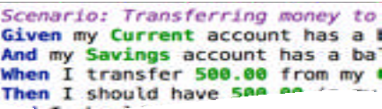








BDD in a nutshell
The business analyst, the developer and the tester elaborate the requirements together.
The scenarios guide the developer and act as automated tests
3
2
They define
1
The business owner
and the business analyst have a conversation about what he needs.
requirements as structured, English- language format "scenarios"
5
4
The tester uses
these scenarios as the basis for her tests
The automated tests provide
A BDD development process
feedback on progress and help document the application

Slide 5
Test Levels

Slide 6
Testing Types
Type | Description
Functional Testing | The purpose of Functional tests is to test each function of the Amboss application, by providing appropriate input, verifying the output against the Functional requirements.
Integration Testing | This includes the integration requirements between Amboss platform and other third party software.
Performance Testing | To verify and ensure that the Amboss applications works under maximum user loads. The business scenarios will be provided by the business stakeholders that will be benchmarked.
Test Automation | The Test Automation will be used as a guide to ensure that test automation is delivering value to the project and that this value is delivered quickly and often.
Compatibility Testing | To check whether Amboss software is capable of running on different hardware, operating systems, applications, network environments or Mobile devices.

Slide 7
Test Execution
QA will take part in the 3 Amigo’s sessions and document the test scenarios
These scenarios are inputs developers for development and act as test cases for testers and feature file for automation
These scenarios are automated using cucumber and Java as language.
Execution reports will act as live documentation for Product Owner

Slide 8
Test Automation
Scenarios of a story card will be automated in the same sprint as agreed as part of DoD(Definition of Done)
Tools used for automation would be Selenium, Cucumber with Java as language
Page Object Pattern will be used as Design pattern
Once scenarios are automated they are undergo merge request review comments and merged to the master of the repository
These scenarios are run on CI/CD pipeline which ran against each build which will give immediate feedback to the developers.

Slide 9
QA TOOL-SET
Name | Description
JIRA | JIRA will be the Amboss primary tool for managing and working on development-related tasks (User Stories) and for Sprint planning from a development perspective.
GitLab | GitLab will be the repository manager which lets teams collaborate on code.
JMeter | JMeter is a performance and functional testing tool that is based around sampling HTTP requests in various forms.
SonarQube | SonarQube is an open source platform for continuous inspection of code quality to perform automatic reviews with static analysis of code to detect bugs, code smells and security vulnerabilities
Cucumber | Cucumber is a tool that supports Behaviour-Driven Development(BDD). Cucumber reads executable specifications written in plain text and validates that the software does what those specifications say.
Protractor | Protractor is an end-to-end test framework for Angular and AngularJS applications. Protractor runs tests against your application running in a real browser, interacting with it as a user would.
Appium | A Cross-browser Mobile Automation Tool. Appium is an open source test automation tool developed and supported by Sauce Labs to automate native and hybrid mobile apps.

Slide 10
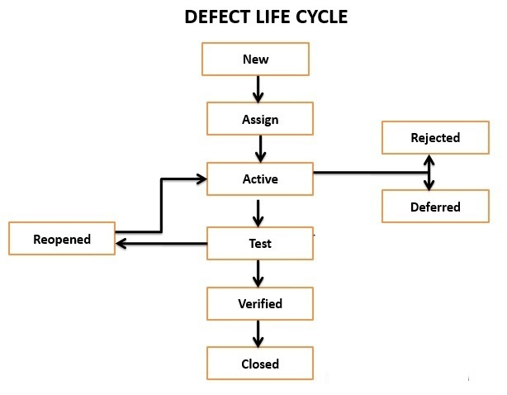
defect management

